Slide 1
VIP/Senior Project Final Presentation Fall 2017
AR-VR-VE for Computer Science Education 1.0
Team Member(s):
Francisco Lozada, Hamilton Chevez, Filip Klepsa, Nicollete Celli, Cristian Cabrera, Lukas Borges, Santiago Bolivar, Bernardo Blum
Product Owner(s):
Francisco Ortega
Instructor:
Masoud Sadjadi
School of Computing and Information Sciences Florida International University
Notes:
Greet your audience, thank them for attending your presentation, introduce yourself, introduce your project, introduce your team members, and quickly indicate what each of you did in a high-level manner, and put more emphasis on your part/contribution.

Slide 2
Project definition
The objective of the project is to present to increase the retention of Computer Science students in introductory courses through the use of augmented and virtual reality technologies.
The ARCSEducation (ARCSE) team’s goal is to create a set of learning activities to increase Computer Science skills in Augmented Reality.
Based on learning theories such as Richard Mayer’s Theory of Multimedia Learning and Constructivism Theory, we speculate that using augmented reality helps decrease cognitive load while learning.
Notes:
Introduce the problem that the whole project tackles and stay focused on the parts that you have been working. Indicate if there is an existing previous system, enumerate its problems/limitations, etc.

Slide 3
Project definition
Five different teams worked together to bring the project to life:
ARCSEducation: Focused on increasing retention rate of Computer Science students.
GR-API-1: Ported a multi-modal interactive library into C++ for future projects to use.
CodeAdventures: Incorporated programming concepts into a virtual reality video game.
LeapMotion Team: Worked on a computer vision algorithm for detecting hand posture.
Notes:
Introduce the problem that the whole project tackles and stay focused on the parts that you have been working. Indicate if there is an existing previous system, enumerate its problems/limitations, etc.

Slide 4
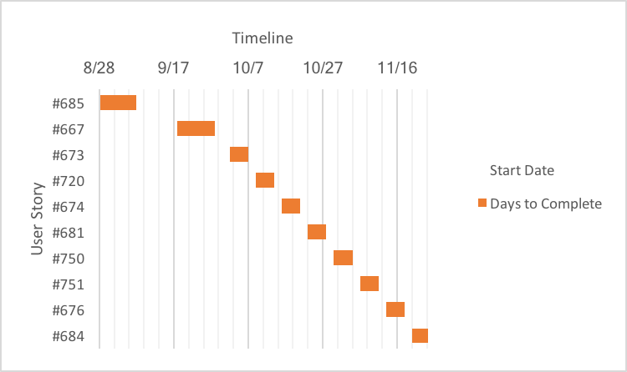
Project Management
Notes:
Project Management (schedule for entire semester) (one slide; Gantt Chart).

Slide 5
Requirements: User Stories
#685 Learn Vuforia API
#686 Augmented Reality Template Scene
#667 Logical OR Gate in AR
#667 Logical AND Gate in AR
#673 Logical XOR Gate in AR
#720 Logical NOT Gate in AR
#674 Binary Conversion Activity
#750 Conversion Activity Modes: Binary to Hex
#751 Mobile Device: Activities Menu
#676 Decoder in Augmented Reality
#684 Balancing Binary Search Tree In Augmented Reality

Slide 6
Requirement: User Story
The most significant user stories were #686 & #674.
#686 led me to reverse engineering the Vuforia Core Samples, it gave me a good grasp on how to use the Vuforia API.
#674 along with its associated user stories of Binary Conversion was the one that required the most implementation and it led to various refactoring that improved the design.

Slide 7
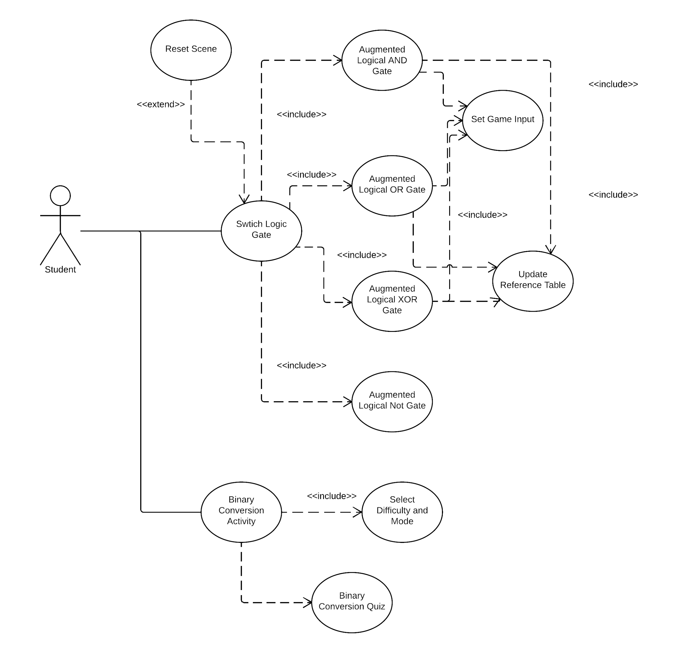
Requirements: Use Cases
Notes:
4. Requirements:
4.1. User stories implemented (one or more slides).
4.2. UML use cases and the use case diagram for the implemented use cases (one or more slides).
4.3. UML sequence diagrams for the implemented use cases.

Slide 8
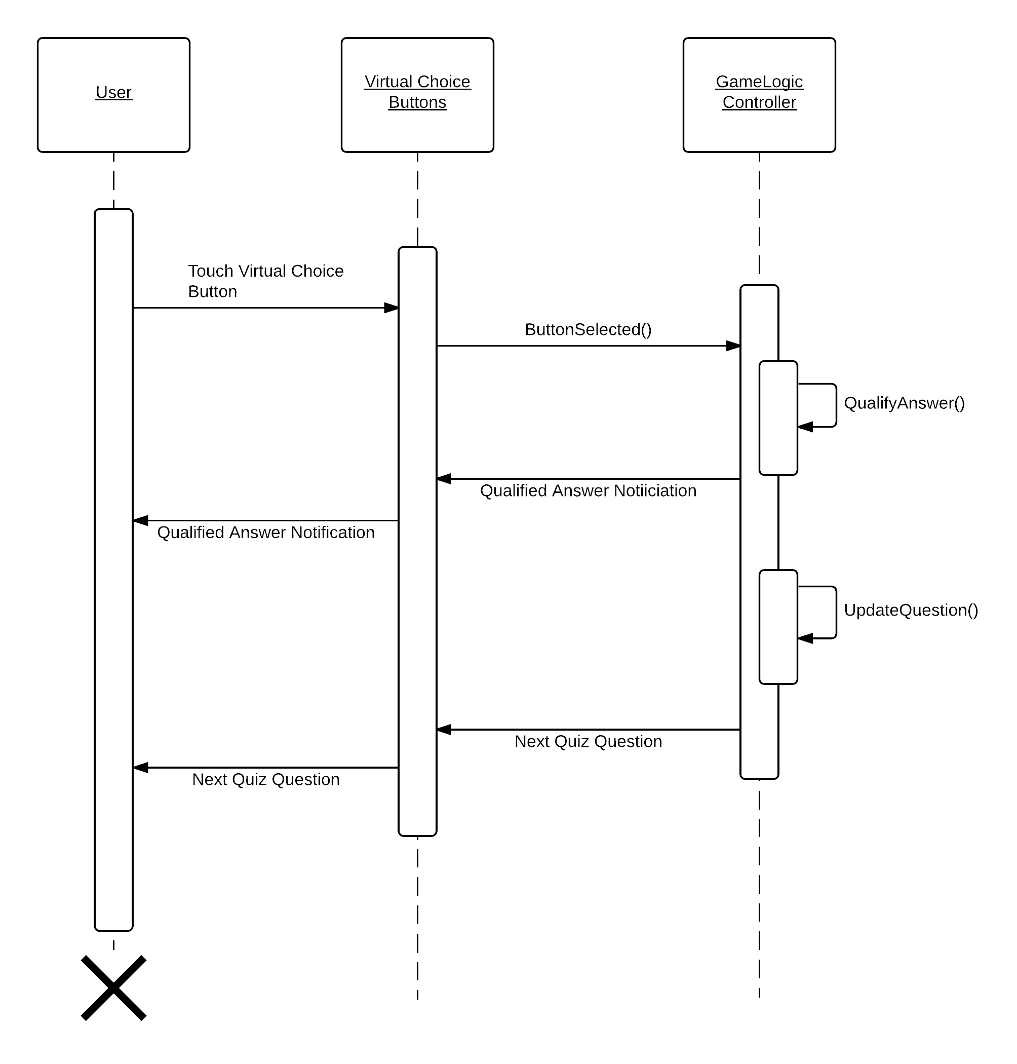
Requirements: Sequence Diagrams
Binary Conversion Quiz
Sequence Diagram
Notes:
4. Requirements:
4.1. User stories implemented (one or more slides).
4.2. UML use cases and the use case diagram for the implemented use cases (one or more slides).
4.3. UML sequence diagrams for the implemented use cases.

Slide 9
System Design: Architecture
The system architecture is divided by scenes.
Each scene follows a MVC. The gameobjects are the view, each controller handles the interaction events. The model of the architecture only serve a significant role in the Binary Conversion Activity. As the logical reference scenes have no need for a model class.
Future iteration of the project requires an improved MVC architecture design or something else.
Notes:
5. System design:
5.1. System decomposition; identify the architecture patterns used (one slide).
5.2. System deployment – h/w and s/w requirements (one slide).
5.3. Persistent data design (one slide).
5.4. Security/Privacy (one slide).

Slide 10
System Design: Deployment
Software Requirements:
Unity, VSCode
Vuforia, Blender,
MacOS High Sierra
Hardware Requirements:
Google cardboard, Nexus 6P phone
2017 Macbook Pro 15”
Notes:
5. System design:
5.1. System decomposition; identify the architecture patterns used (one slide).
5.2. System deployment – h/w and s/w requirements (one slide).
5.3. Persistent data design (one slide).
5.4. Security/Privacy (one slide).

Slide 11
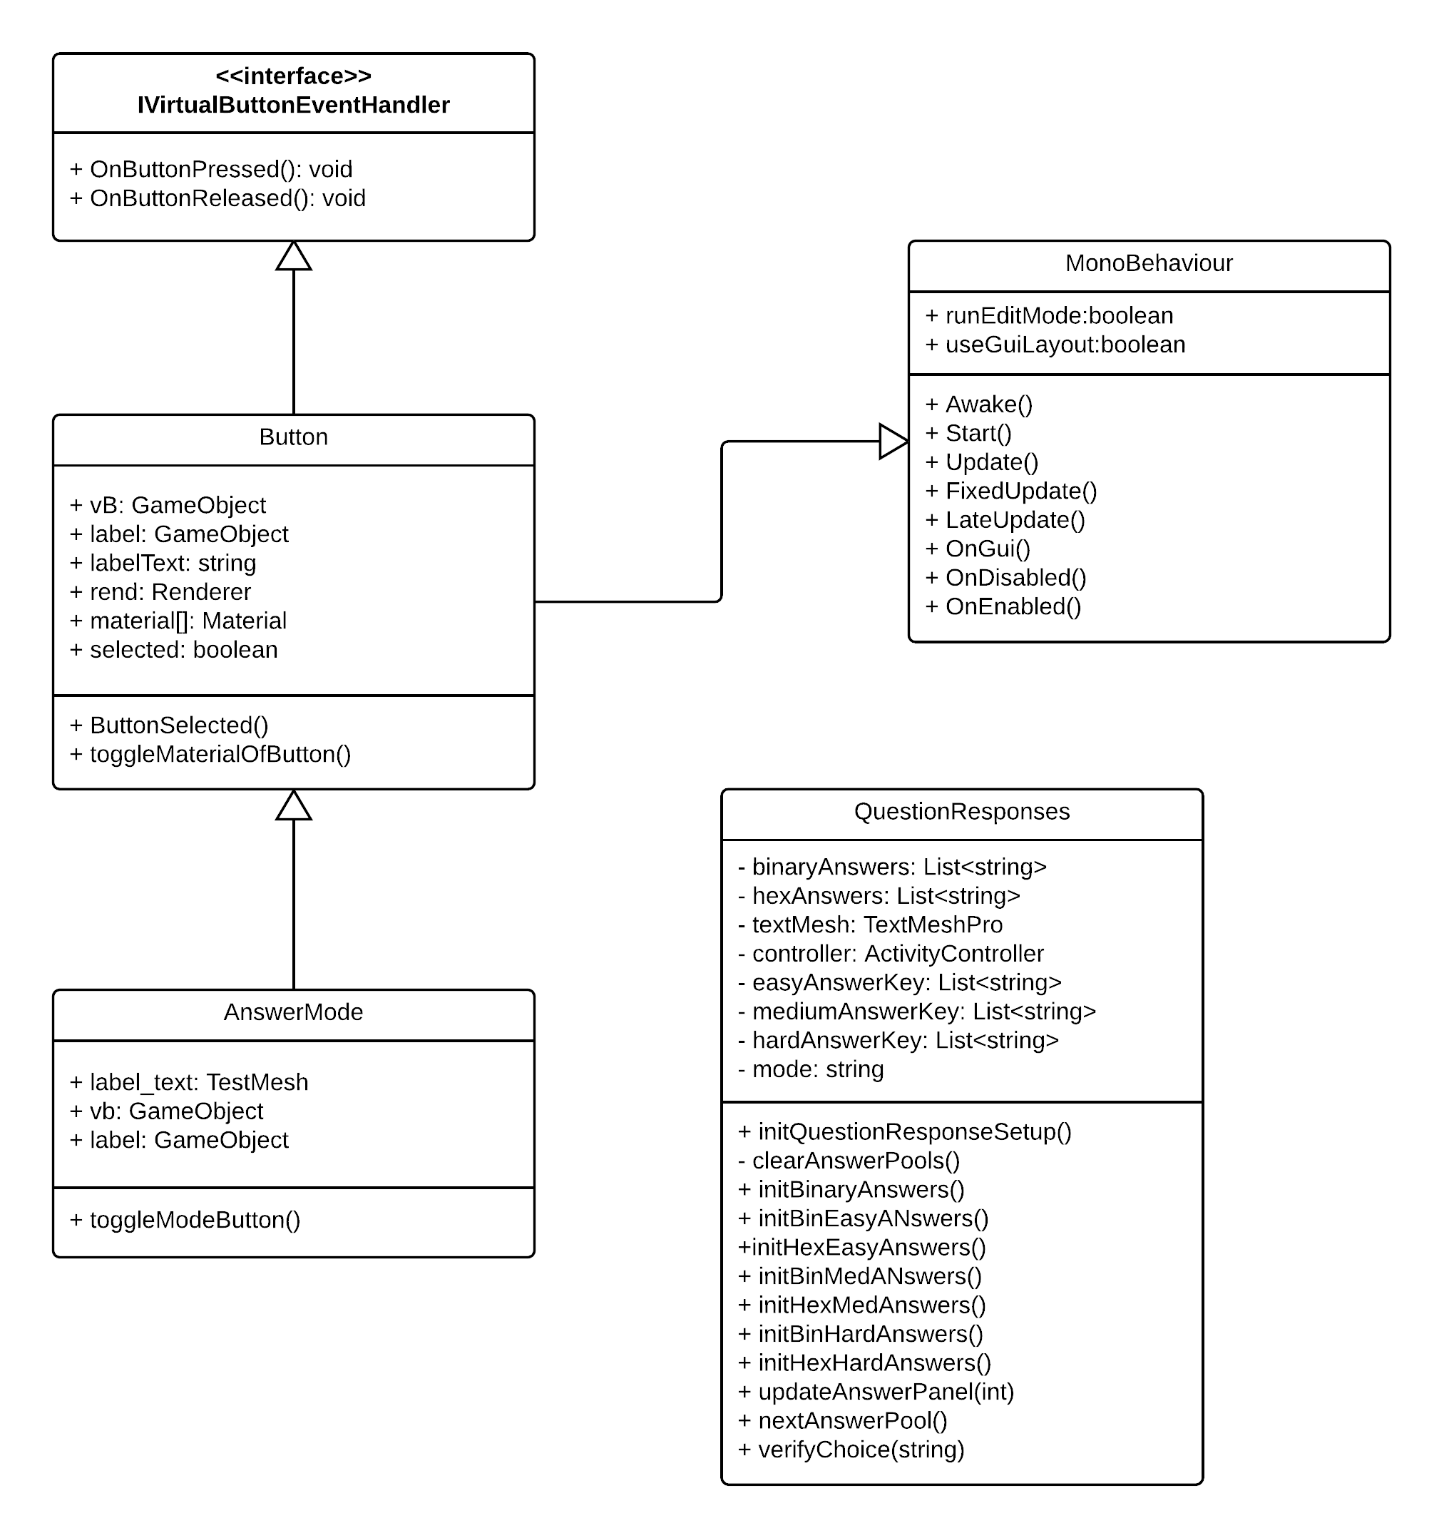
Minimal Class Diagram
The project is split into multiple scenes as a result each scene is its own isolated project. All scene class diagrams inherit from MonoBehaiour (Unity) and implement the IVirtualButtonEventHandler interface in order to use virtual buttons.
Notes:
6. Detailed design:
6.1. Minimal class diagram. Identify the design patterns used (one or more slides).
6.2. State machine for the main control object or the most important object of the implemented uses cases (one or more slides).
6.3. Main algorithm used related to an implemented use case described above (one or more slides).

Slide 12
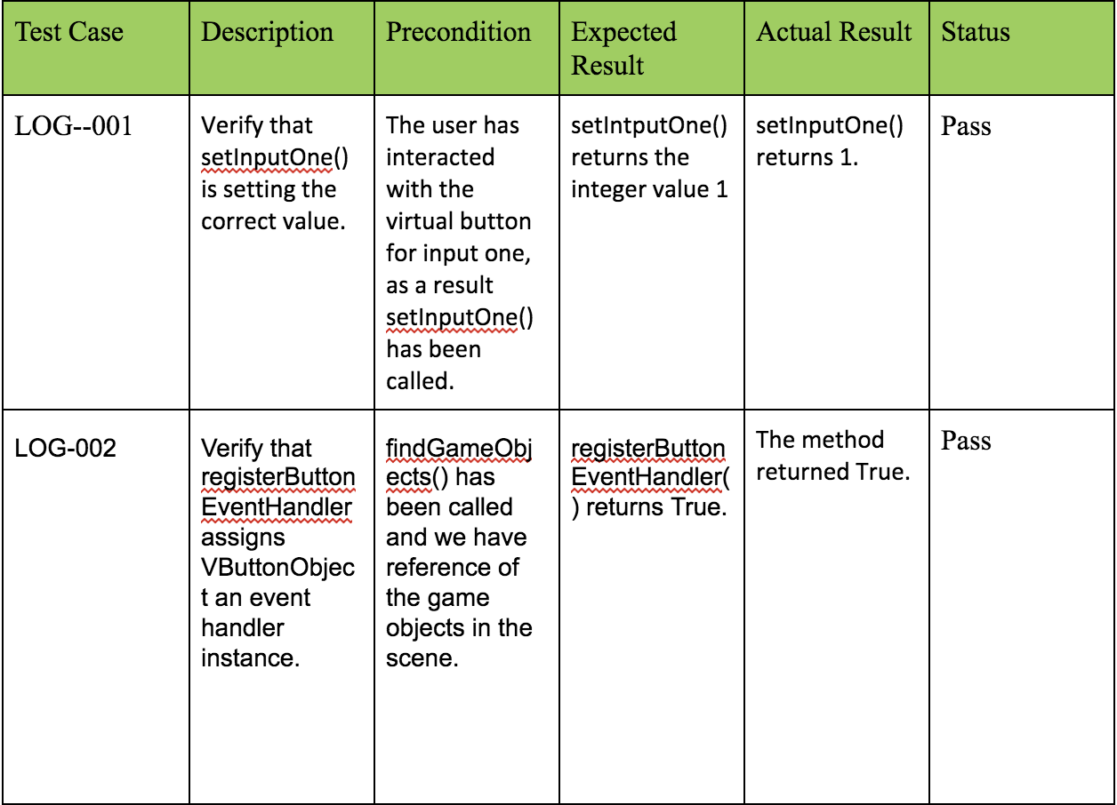
Test Suites and Test Cases
Notes:
7. Test Suites and Test Cases (one sunny day and one rainy day) for the use case represented in part (5) above (2 slides).
7.1 One sunny day and one rainy day for the implemented use cases (one or more slides).
7.2 Automated test scripts for the implemented use cases (one or more slides).

Slide 13
Summary
Summary: Developing for the ARCSEducation project has been an evolutionairy learning problem. The inital impression of Vuforia’s virtual buttons held grate promise but actual use proved to cause problems. The next iteration of the project will require a refactoring in order to use a different approach for interacting with the augmented reality content.
Contact Information: hchev001@fiu.edu
Questions?
Thank You!
Notes:
Summarize your contribution
Include your contact information
Ask if anyone has any questions for you.
Thank your audience

